Slide 1
Ways to Support [Insert Church Name]

Slide 2
Overview
Why tithing is important to [Insert Church Name]
Who is Vanco?
How to give to [Insert Church Name]
Additional questions

Slide 3
Why Tithing is Important
Helps us accomplish and expand our missions
Enables us to do good works in our local communities
Supports our pastors and faith team
Helps us maintain and grow our physical church
Allows us to invest in technology for new ways to gather and worship
Notes:
Helpful tip: when going through this slide, use stories to connect with your members and guests. Your stories should be conversational, relatable and memorable. For example, how did your food drive impact your local community along with how it impacted some of the members who participated?

Slide 4
Meet Vanco, Our Online Giving Provider
v
v
v
Over 20 years of experience
Partnered with over 20,000+ churches
Multiple ways to give
v
v
V{
Highlights our stories and missions
Easy to use
Saves our staff time hours
Notes:
Vanco provides multiple ways to give – online through your church's website and through a mobile app. People want to donate to a cause that they have a personal connection to, so point out the missions they can donate to with the stories about your work to help them relate.

Slide 5
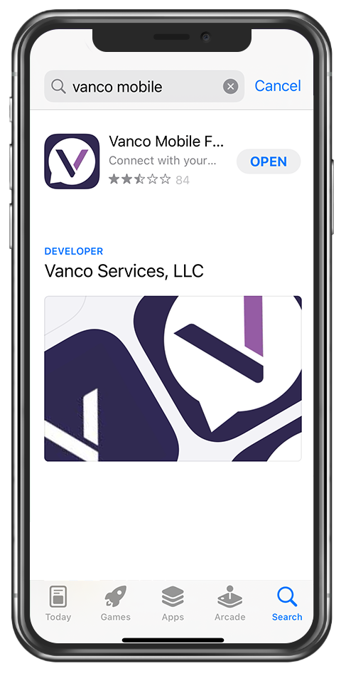
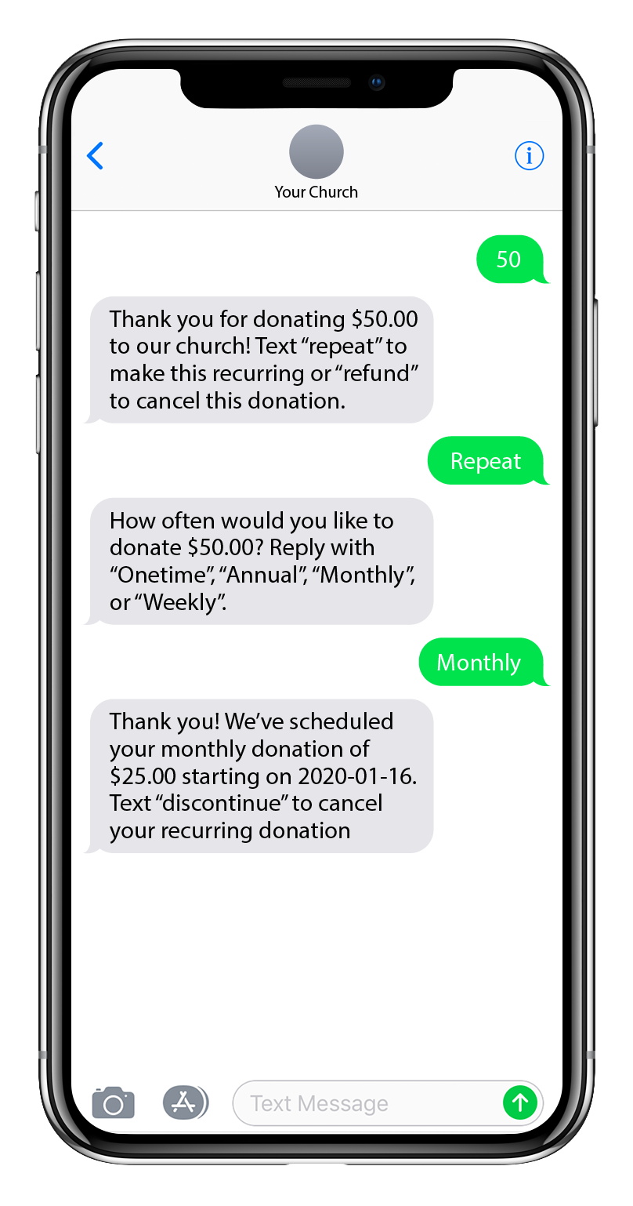
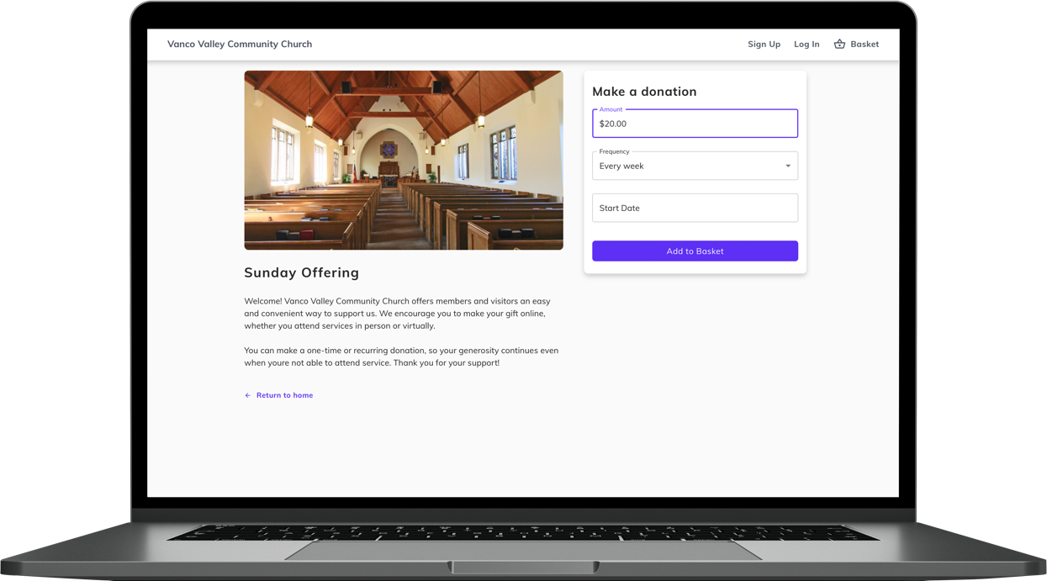
How You Can Give To [Insert Church Name]
ONLINE
MOBILE
TEXT
SWIPE

Slide 6
Giving through our online site

Slide 7
1. Select your funds and amount
Select your fund.
Click the Donate button.
Choose a donation amount and frequency
Proceed to payment.

Slide 8
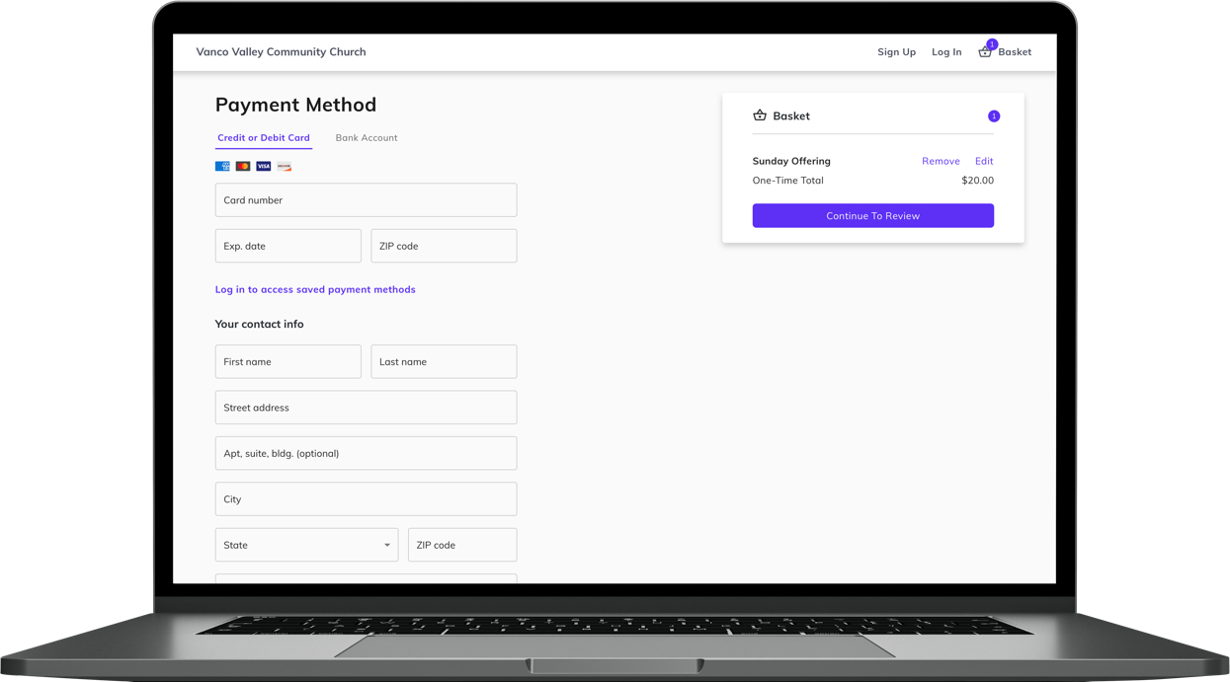
2. Enter payment method
Enter your credit card, debit card or checking account information.
If you sign up for a free account, you can save your payment information for future donations.

Slide 9
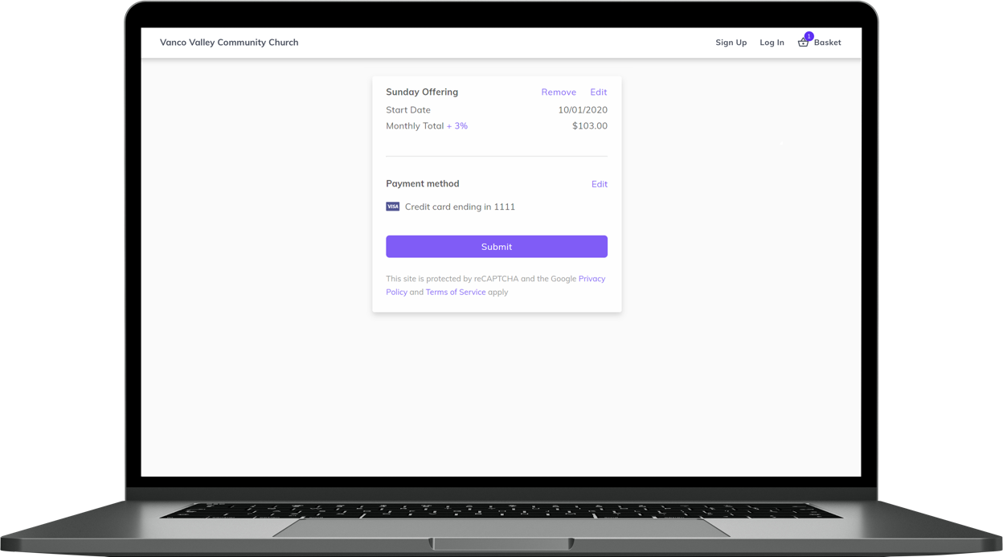
3. Complete donation
Review and submit your gift by clicking Submit.

Slide 10
How to Give Using Vanco Mobile
Visit the App store or Google Play to download the Vanco Mobile app for free!
Notes:
Helpful tip: When walking members through these slides, consider telling them the story of one of your missions as an example on how to give and remind them of how their gift impacts them.

Slide 11
1. Search for [INSERT CHURCH NAME]
Enter [INSERT CHURCH NAME].
Or use the invite code and click Search.
Then, select our church.

Slide 12
2. Select your fund and amount
Choose your fund.
Select donation frequency.

Slide 13
3. Enter payment method
Vanco accepts:
Credit cards
Debit cards
Bank account information
You can save this payment method for future donations.

Slide 14
4. Choose to cover processing fees
You can choose to cover the donation processing fees by adding a small amount on top of your gift.
Click the button to opt in.

Slide 15
5. Complete your donation
Review and complete your gift by clicking submit.

Slide 16
Text Giving
Text [Insert your text giving number] to give to [Insert church name] today!

Slide 17
Have questions on ways to give?
Contact [Name] at [Phone number] or [email address] or stop by the front office.

Slide 18
Thank You!

