Slide 1
Support Our Mission with eGiving
This Easter, consider making your gifts using our eGiving tools. [Church Name] offers [include the eGiving tools your church uses].

Slide 2
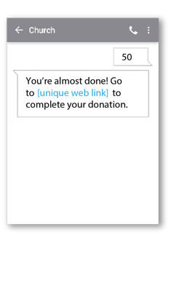
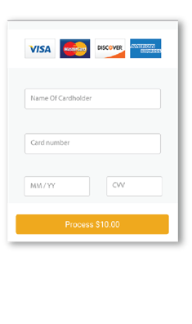
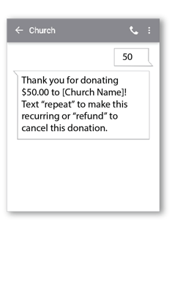
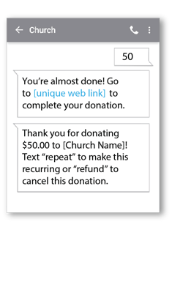
Text Your Donation
Simply text your gift amount to [### ### ####] and then follow the instructions on your phone to complete your donation.
1. Get Started
2. Register
3. Give
4. Repeat
Enter our 10-digit Vanco Text number and the amount you wish donate, then press send.
You will receive a registration link. Click the link and enter your contact and payment information. Tap “Process.”
After registration is complete, you will receive a verification text as
well as a receipt via email.
For future giving, simply send a text with the amount you wish to give, and it will process automatically.

Slide 3
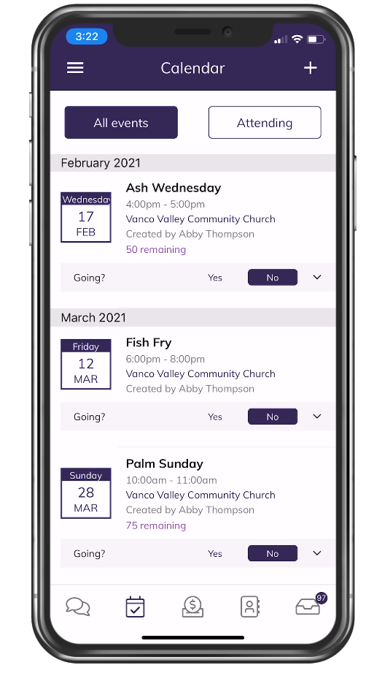
Use Our
Mobile App
This Easter

Slide 4
Download the Free Vanco Mobile App
Search “Vanco Mobile” in the app store.
Search for our church’s name [Church Name] in the Vanco Mobile app.
Donate!
In less than five minutes, you can set up an account or give using a guest account.

Slide 5
Consider Giving Online This Easter
Visit [Church Website].
Locate the Give button.
Donate!
It only takes a minute to set up an account or give as a guest. We appreciate your generosity this Easter!

Slide 6
Did you know you can participate in our services online?
You can! We use Vanco Live to bring the warmth and fellowship of our services to you no matter where you are. It's more than a livestream. It's the full church experience.

