Slide 1

Support Our Mission with eGiving
Consider making your contribution through our eGiving tools! You can make a one-time gift or set up recurring donations.
[Church Name] offers [include the eGiving tools your church uses].

Slide 2

Online Giving Made Easy
Make a one-time contribution or set up recurring gifts through our website’s donations page.
Visit [CHURCH WEBSITE].
Locate the Give button.
Donate!
It only takes a minute to give. We appreciate your generosity!

Slide 3

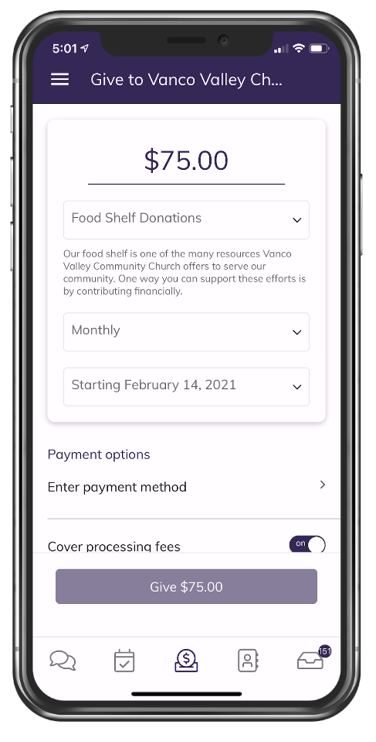
Give Anytime, Anywhere with Our Church’s App!

Slide 4

Use Our Vanco Mobile App
Download our church’s app from the Apple App Store or Google Play by searching for Vanco Mobile Faith Engagement.​
Find our church by searching for [CHURCH NAME].​
Give!
Join groups and events in the app. Stay in touch and participate.

Slide 5

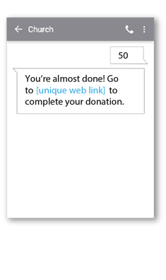
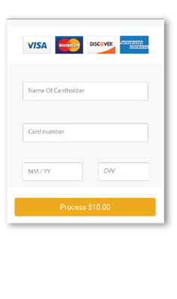
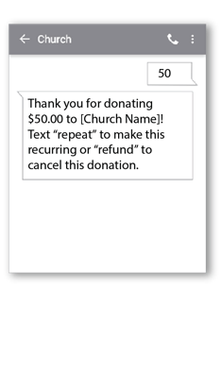
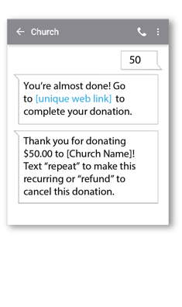
Text Your Gift
Giving by text is easy. Simply text your donation amount to [###.###.####] and follow the instructions on your phone to complete your gift.​
1. Get Started
2. Register
3. Give
4. Repeat

