Slide 1

How to Use Vanco Mobile
Vanco Mobile is the church engagement app that keeps our members in touch, facilitates communication and makes giving easy during virtual ministry.
Using Vanco Mobile is easy for members. You can join groups, sign up for events and chat with friends, church members and leaders all within the app. Just follow these simple directions after you download Vanco Mobile from your app store and search the app for our church’s name.
© 2020 VANCO. ALL RIGHTS RESERVED.

Slide 2
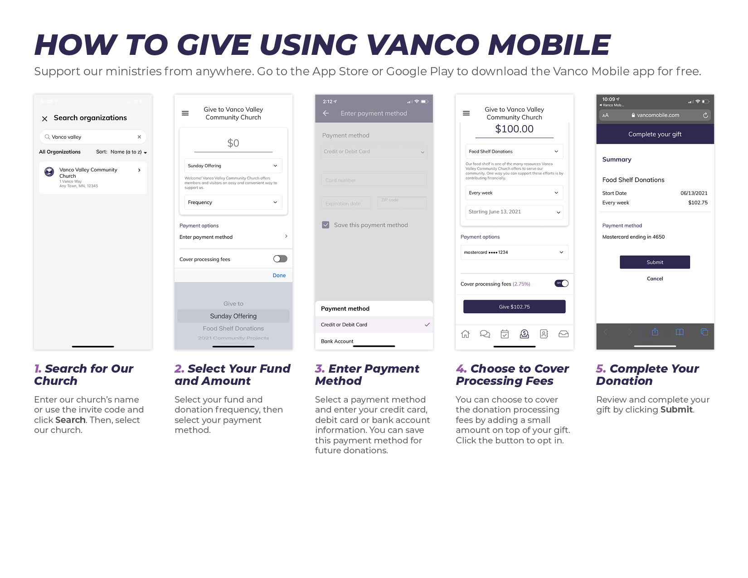

Slide 3
Join a Group
You will receive a notification when you have been invited to join a group.
Once you select an invitation, you will be prompted to accept or decline the invitation.
Then, simply accept, decline or have the app ask you again the next time you click on the invitation.

Slide 4
Send a Chat
Sending a chat in Vanco Mobile is similar to any texting app.
First, go to the directory and type in the name of the person you want to chat with.
Once you’ve found them, select their name, and tap the Direct Message button.
Next, type your message and hit Send. It’s that simple!

Slide 5
RSVP to an Event
Event invitations appear in your inbox.
Tap the invitation to see the details.
Then accept, decline or choose to be asked again later.

