Slide 1
How to Use Vanco Online
Vanco Online is the customizable eGiving and payment tool that connects churches with their communities.
Using Vanco Online is easy for church members. You can support seasonal and year-round missions, make one-time gifts or set up recurring donations. Just follow these simple directions when you visit your church’s website.
© 2020 VANCO. ALL RIGHTS RESERVED.

Slide 2
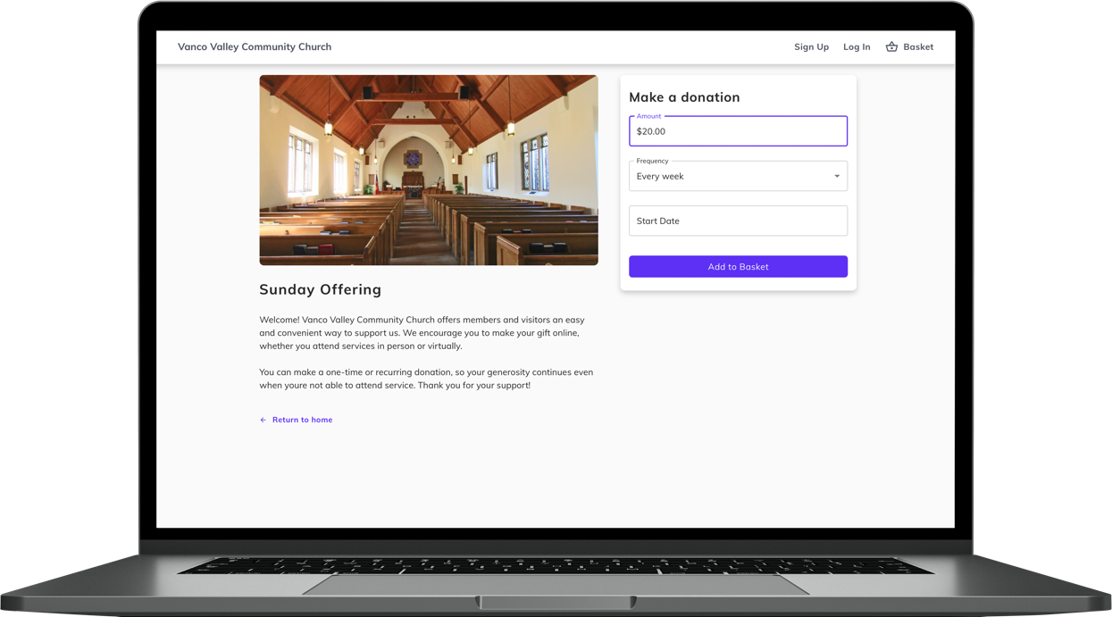
1. Select Your Funds and Amount
Select your fund and click the “Donate” button. From here, you can choose a donation amount and frequency, then proceed to payment.

Slide 3
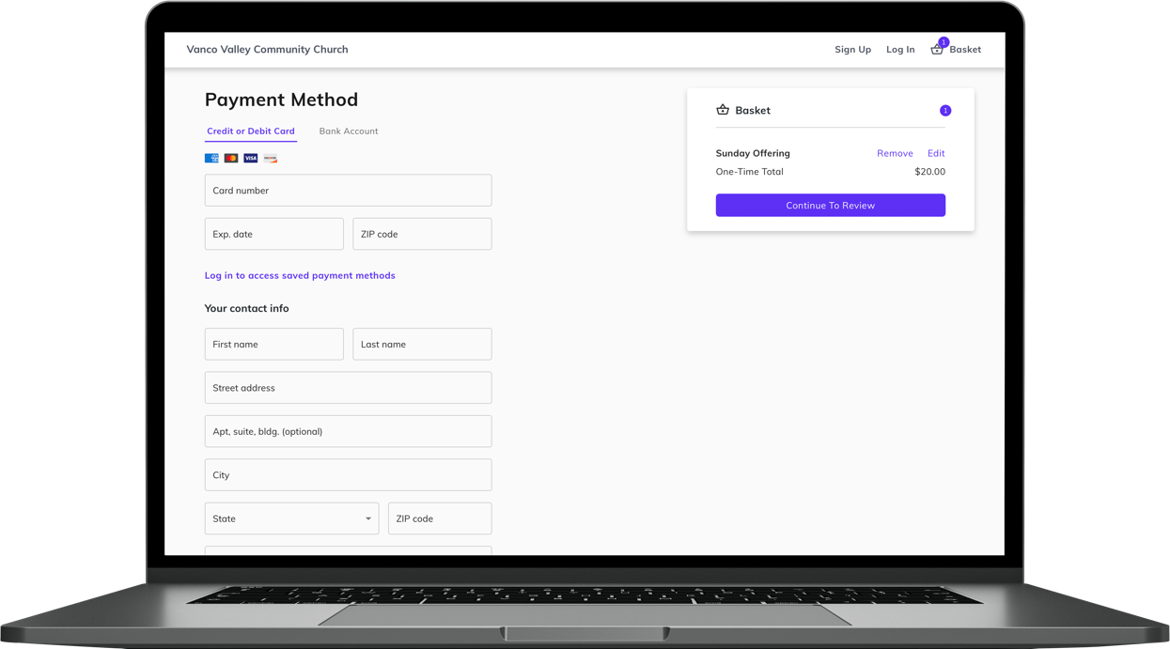
2. Enter Payment Method
Enter your credit card, debit card or checking account information. If you sign up for a free account, you can save your payment information for future donations.

Slide 4
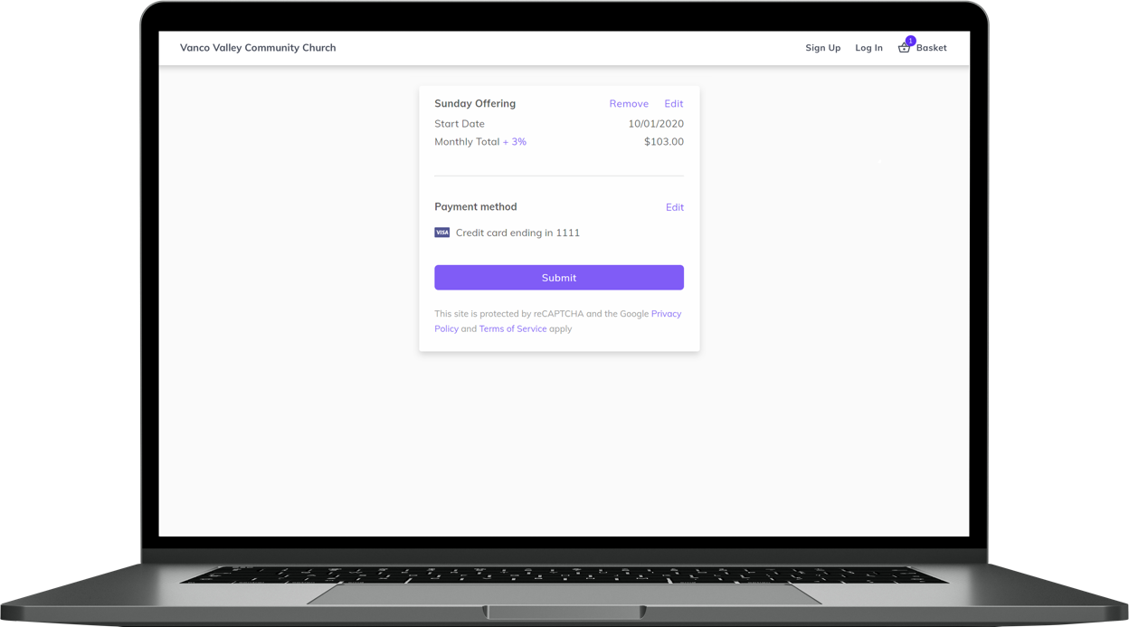
3. Complete Donation
Review and submit your gift by clicking “Submit”.

Slide 5
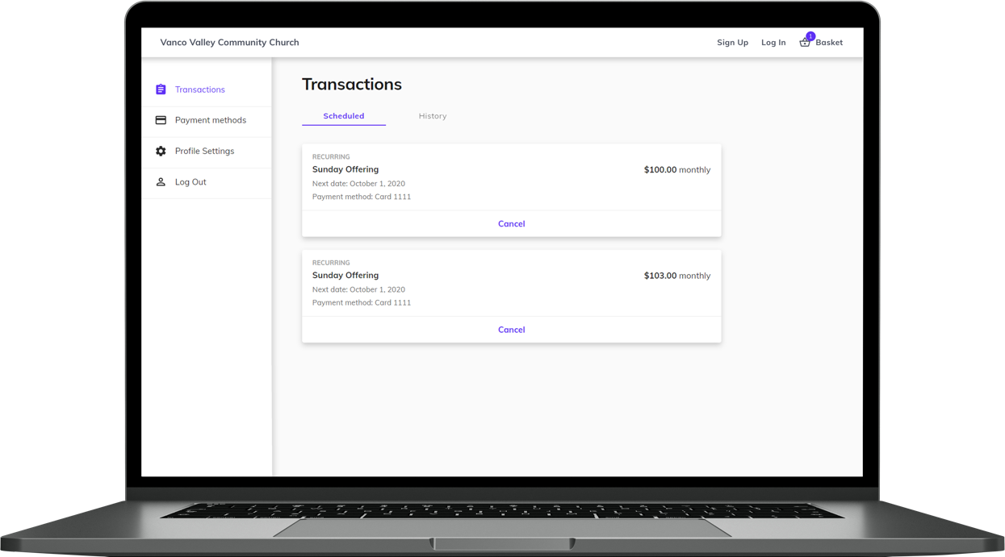
Vanco Online Account Features
From your Vanco Online account, you can review your giving history, manage recurring donations or update payment information.
If you have questions about using Vanco Online, please see a member of your church staff.

